Slide 1
Euler Path
Team #6:
Dongbo Liu, Dmitry Dolgopolov, Mher Torjyan, Shiyu Zhang

Slide 2
Problem: Flight Planning
When travelling to the the US, foreigners need help planning out their travel.
To save money and enjoy more sights they can use Euler’s Path
Vertices: Cities or Airports
Edges: flights from one city to another
Notes:
Our application allows users to generate a graph of cities after which they have the option to add, remove, or print out cities. It will also allow you to traverse the graph and print out the Eulerian path of the graph (If possible).

Slide 3
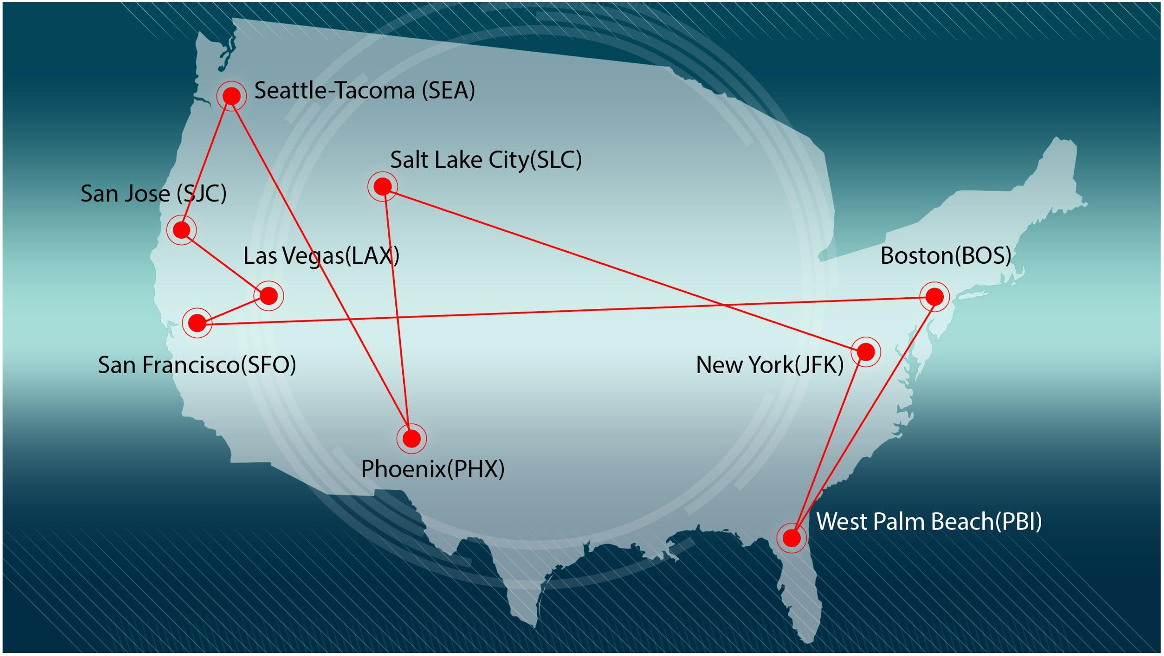

Slide 4
Algorithm
An Euler path is a path that uses every edge of a graph exactly once.
An Euler path starts and ends at different vertices.
An Euler path must have either 0 or 2 odd vertices.
Fleury’s Algorithm is for traversing Eulerian Path.

Slide 5
Graph Traversal
For graph traversal we are using Fleury’s Algorithm. It will be demonstrated in action in the next slides.

Slide 6
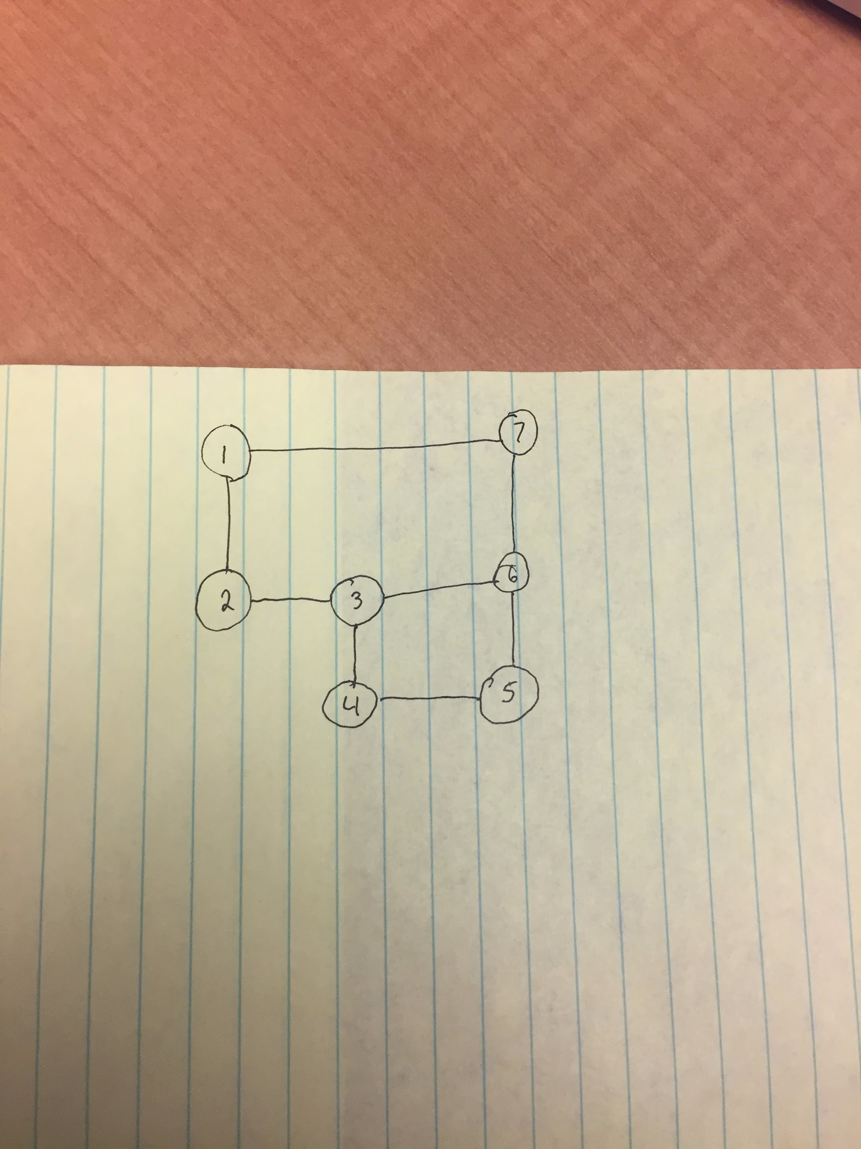

Slide 7
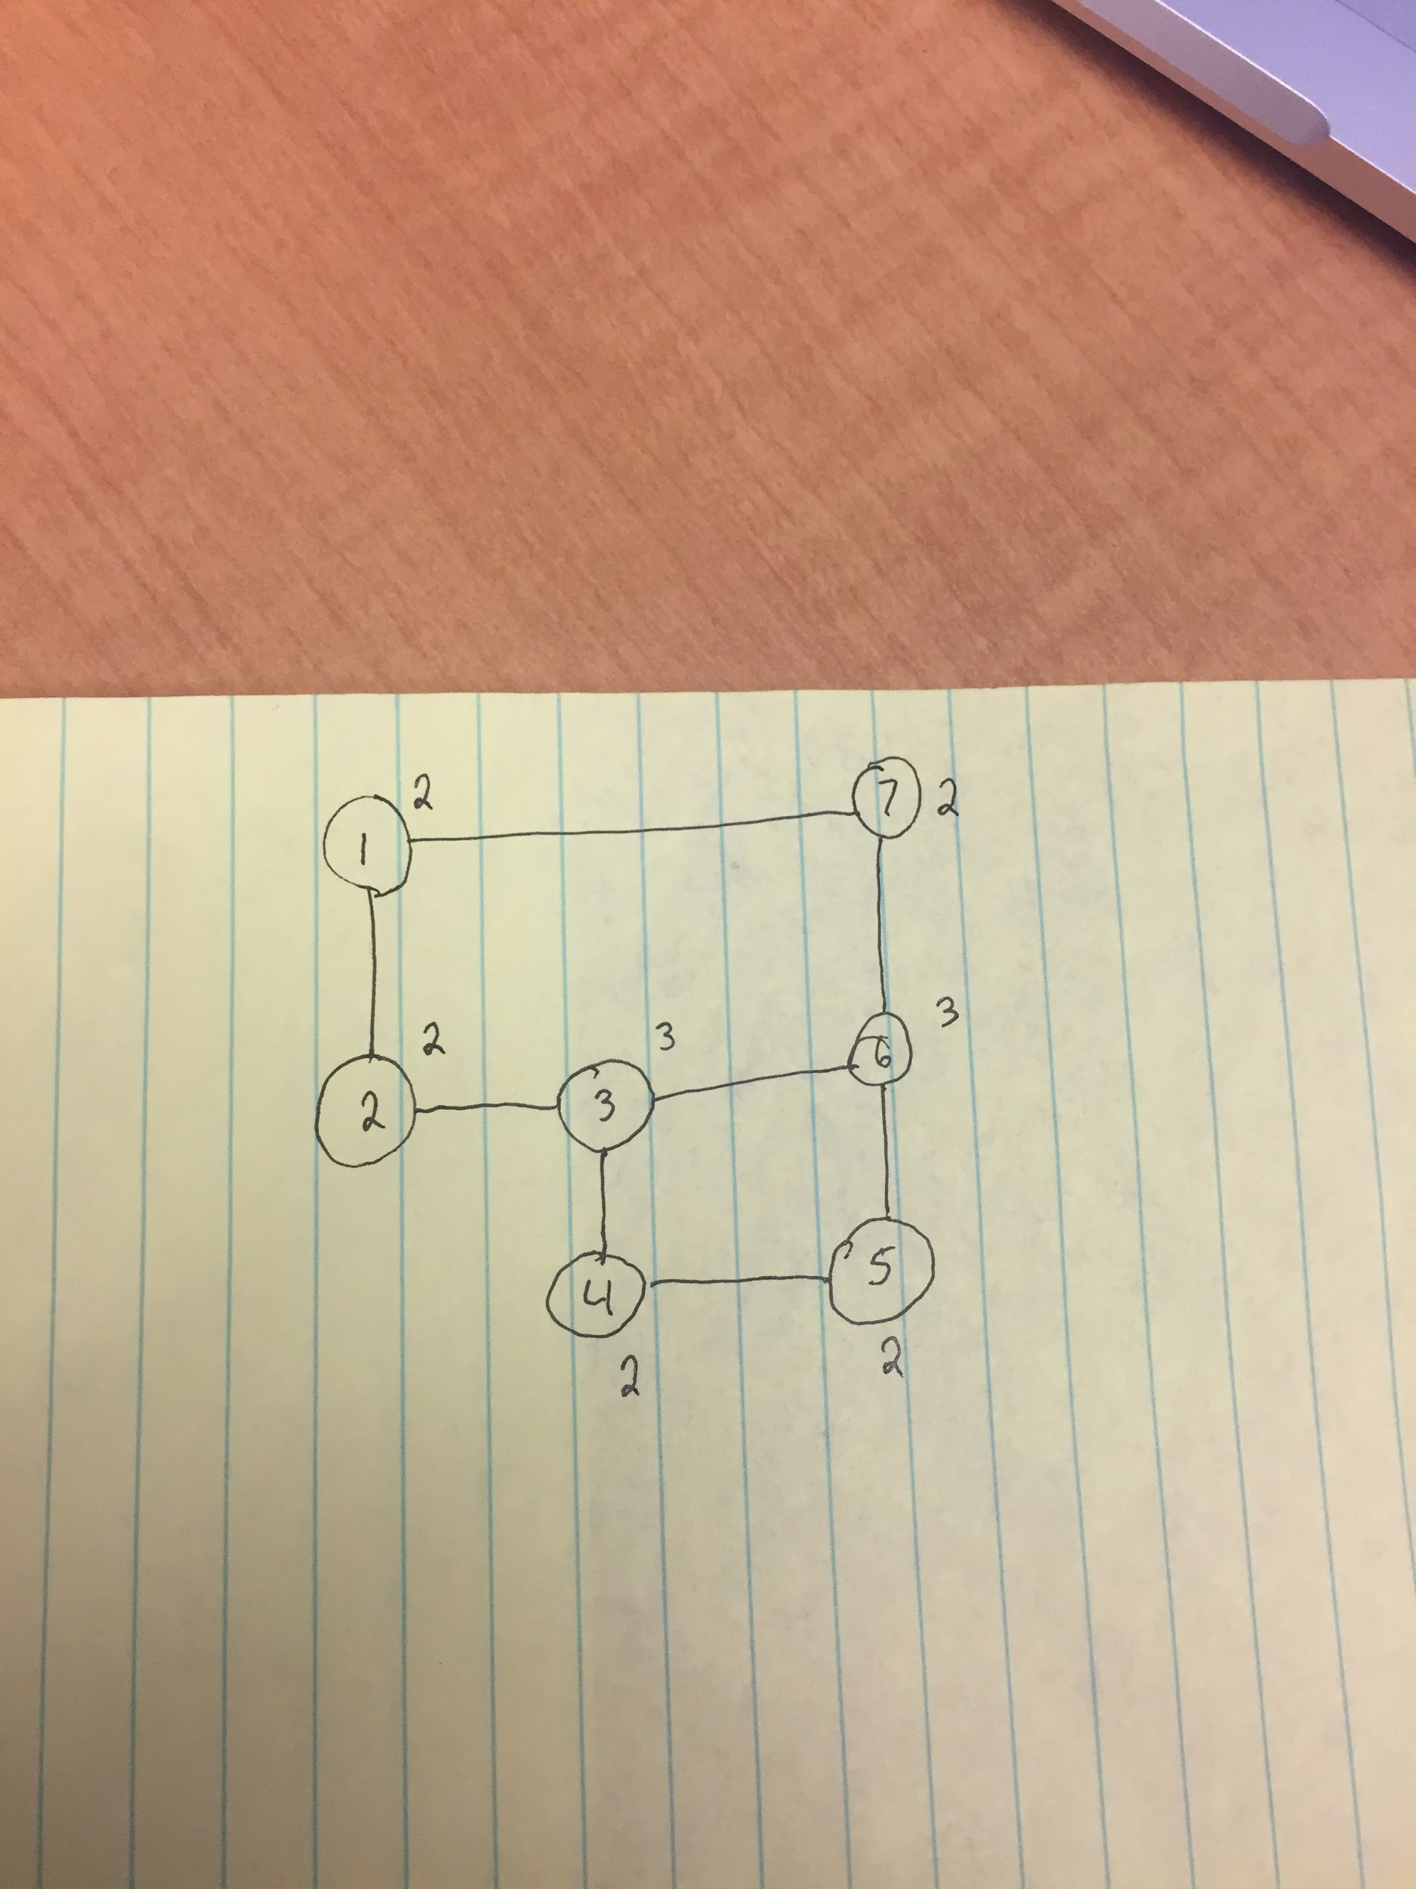

Slide 8
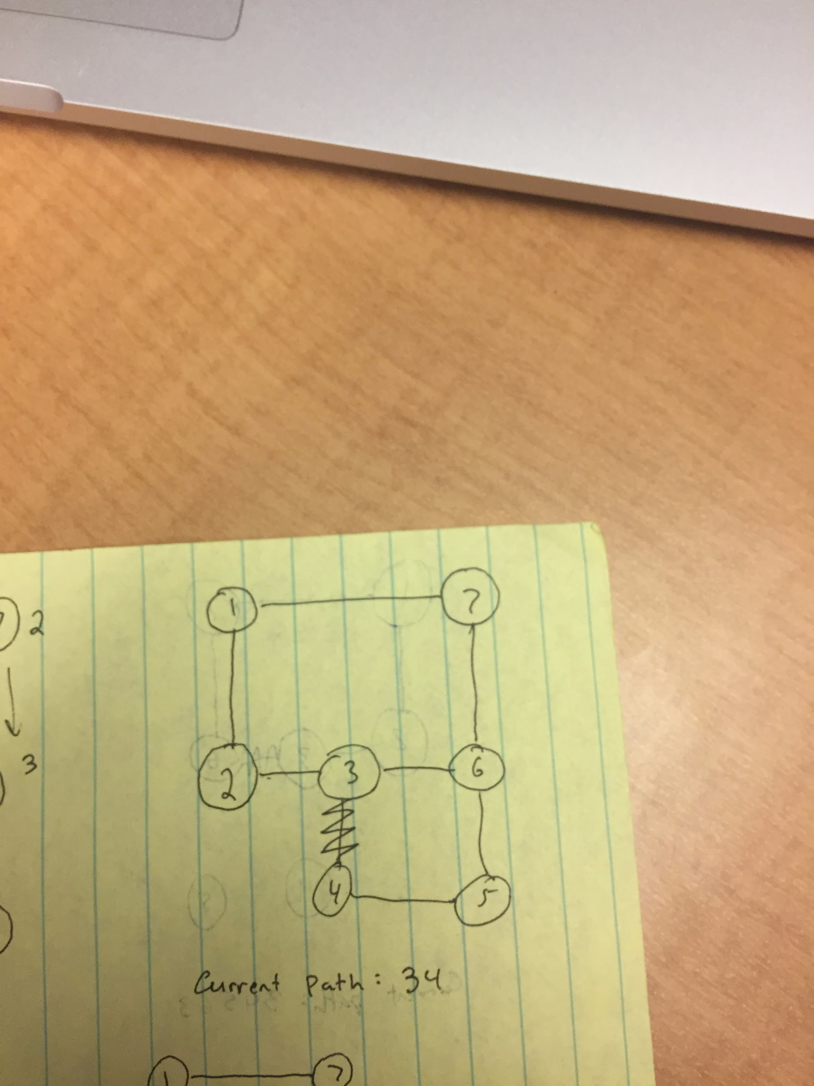

Slide 9
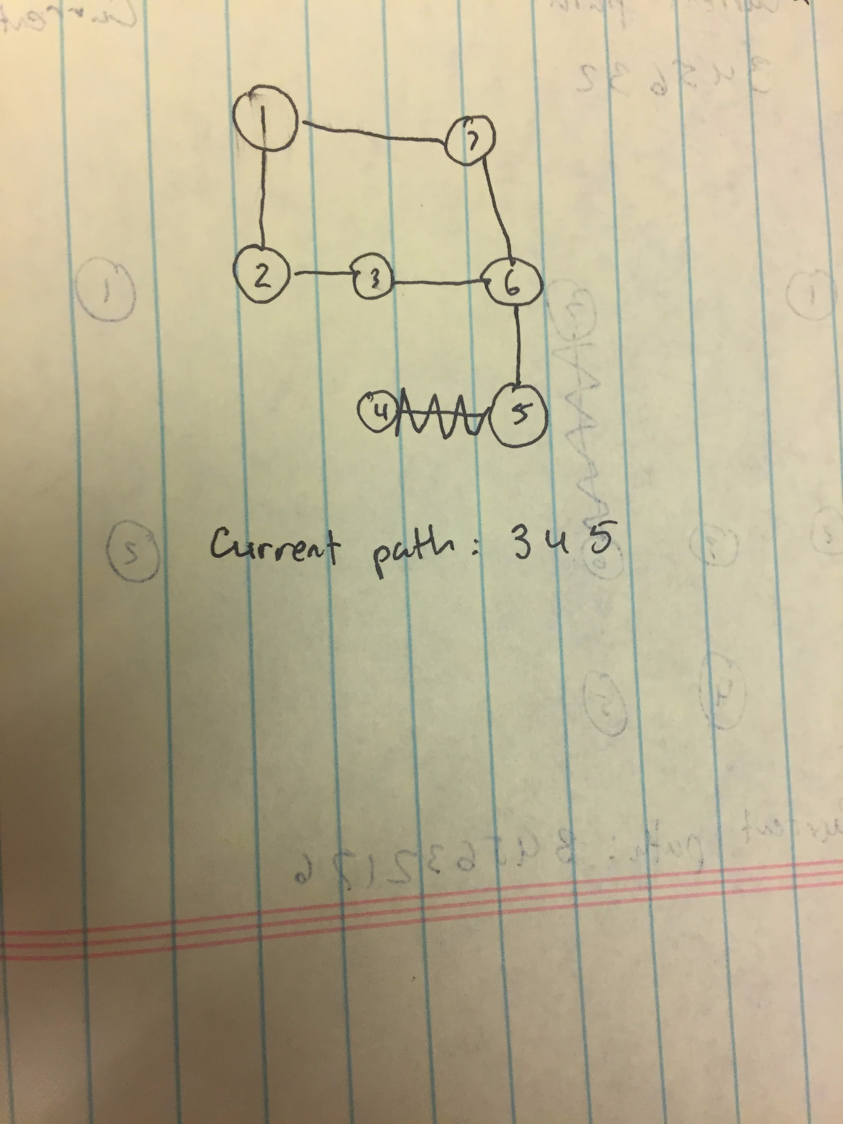

Slide 10
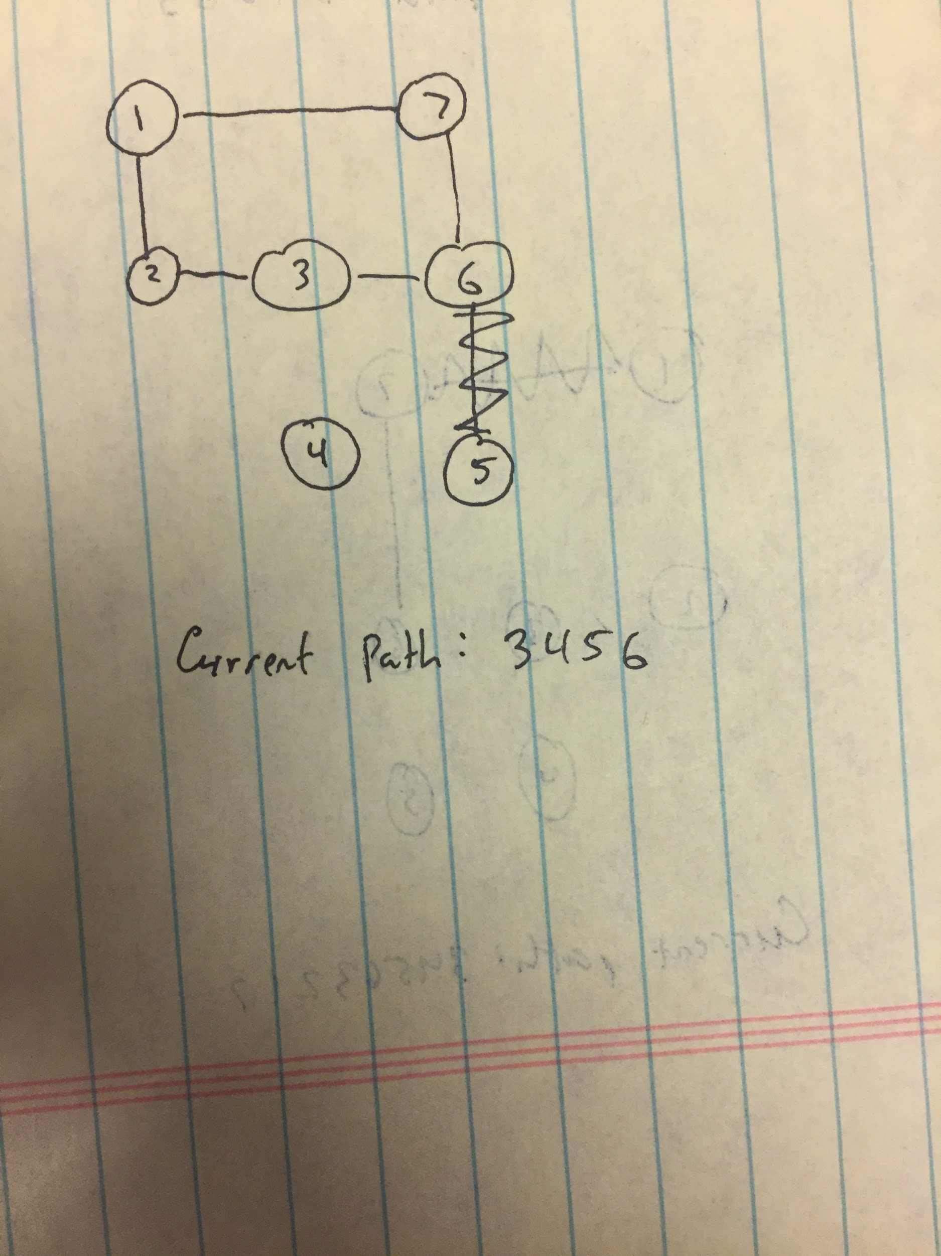

Slide 11
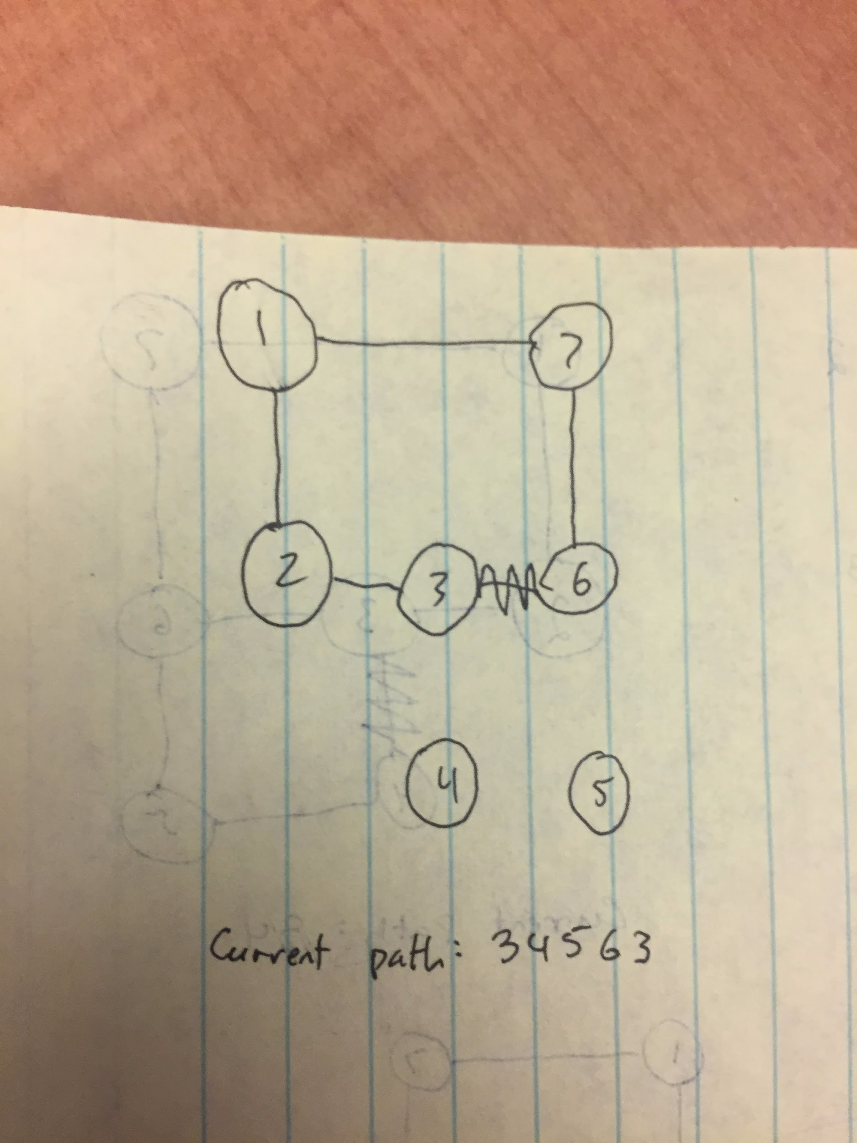

Slide 12
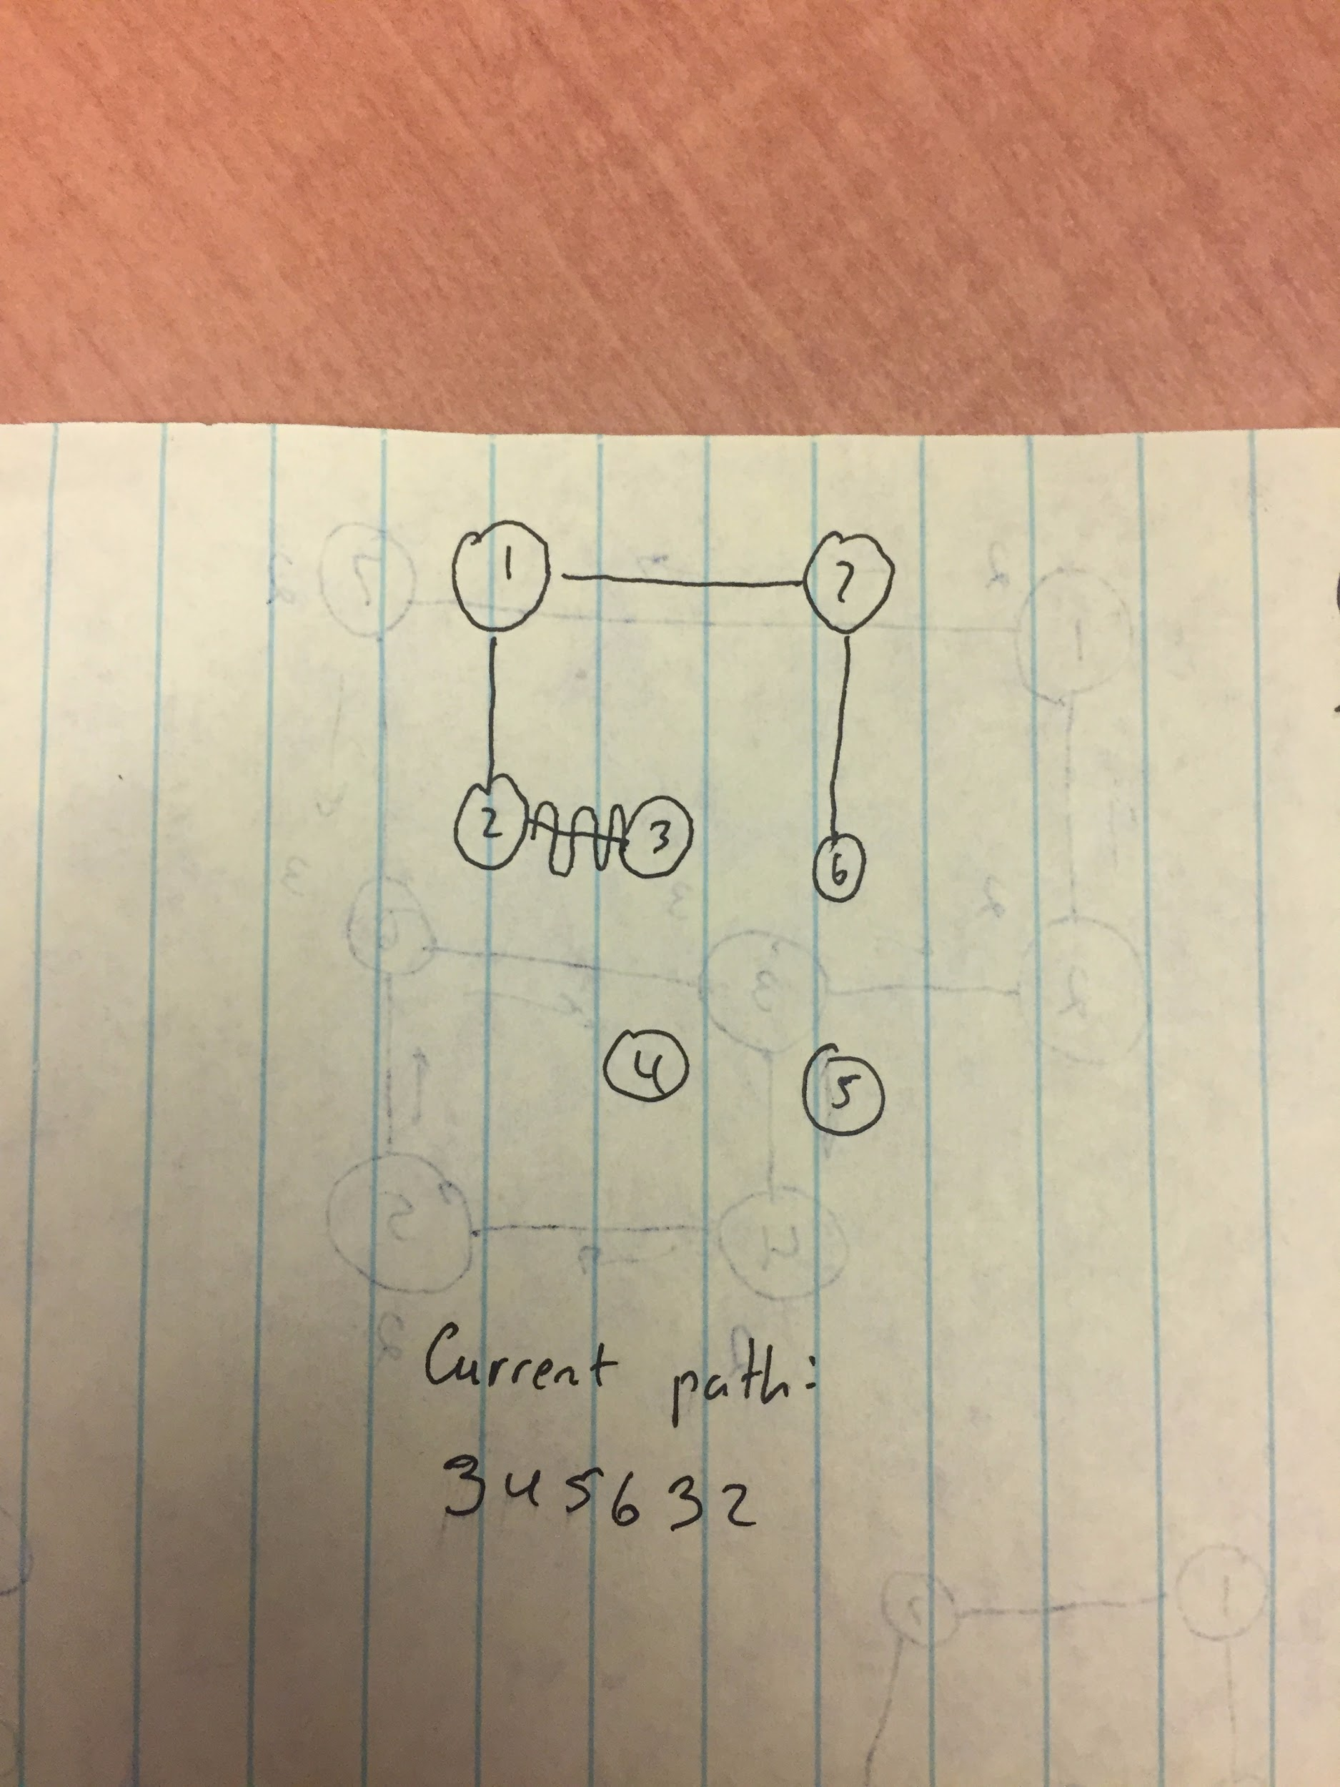

Slide 13
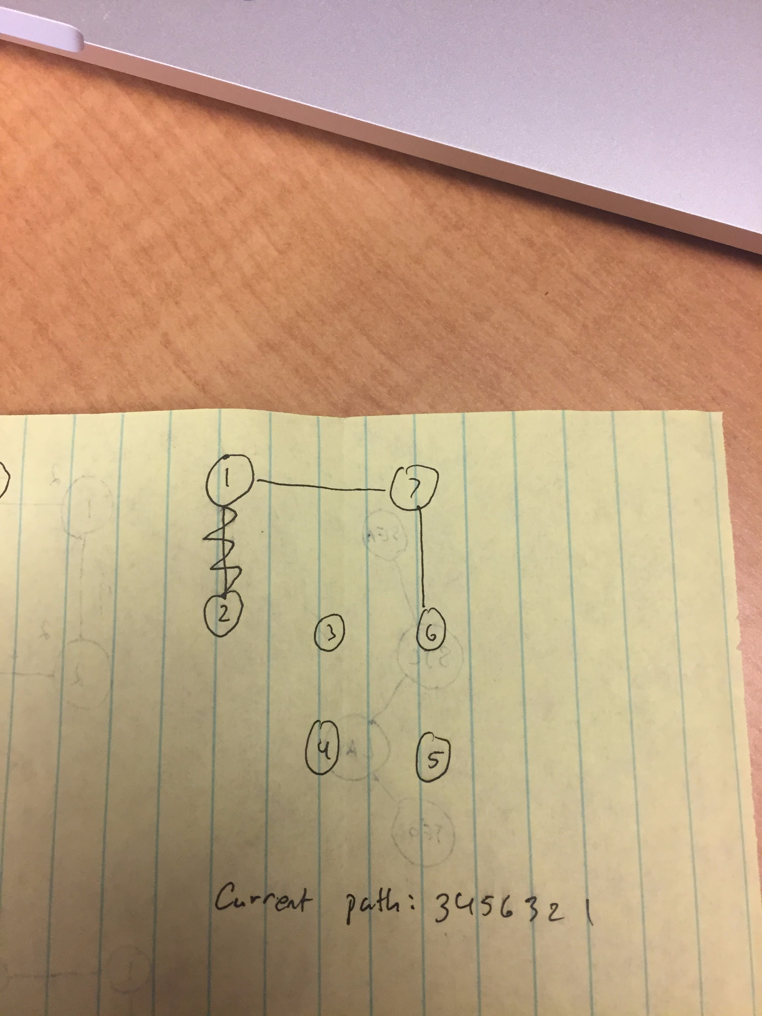

Slide 14
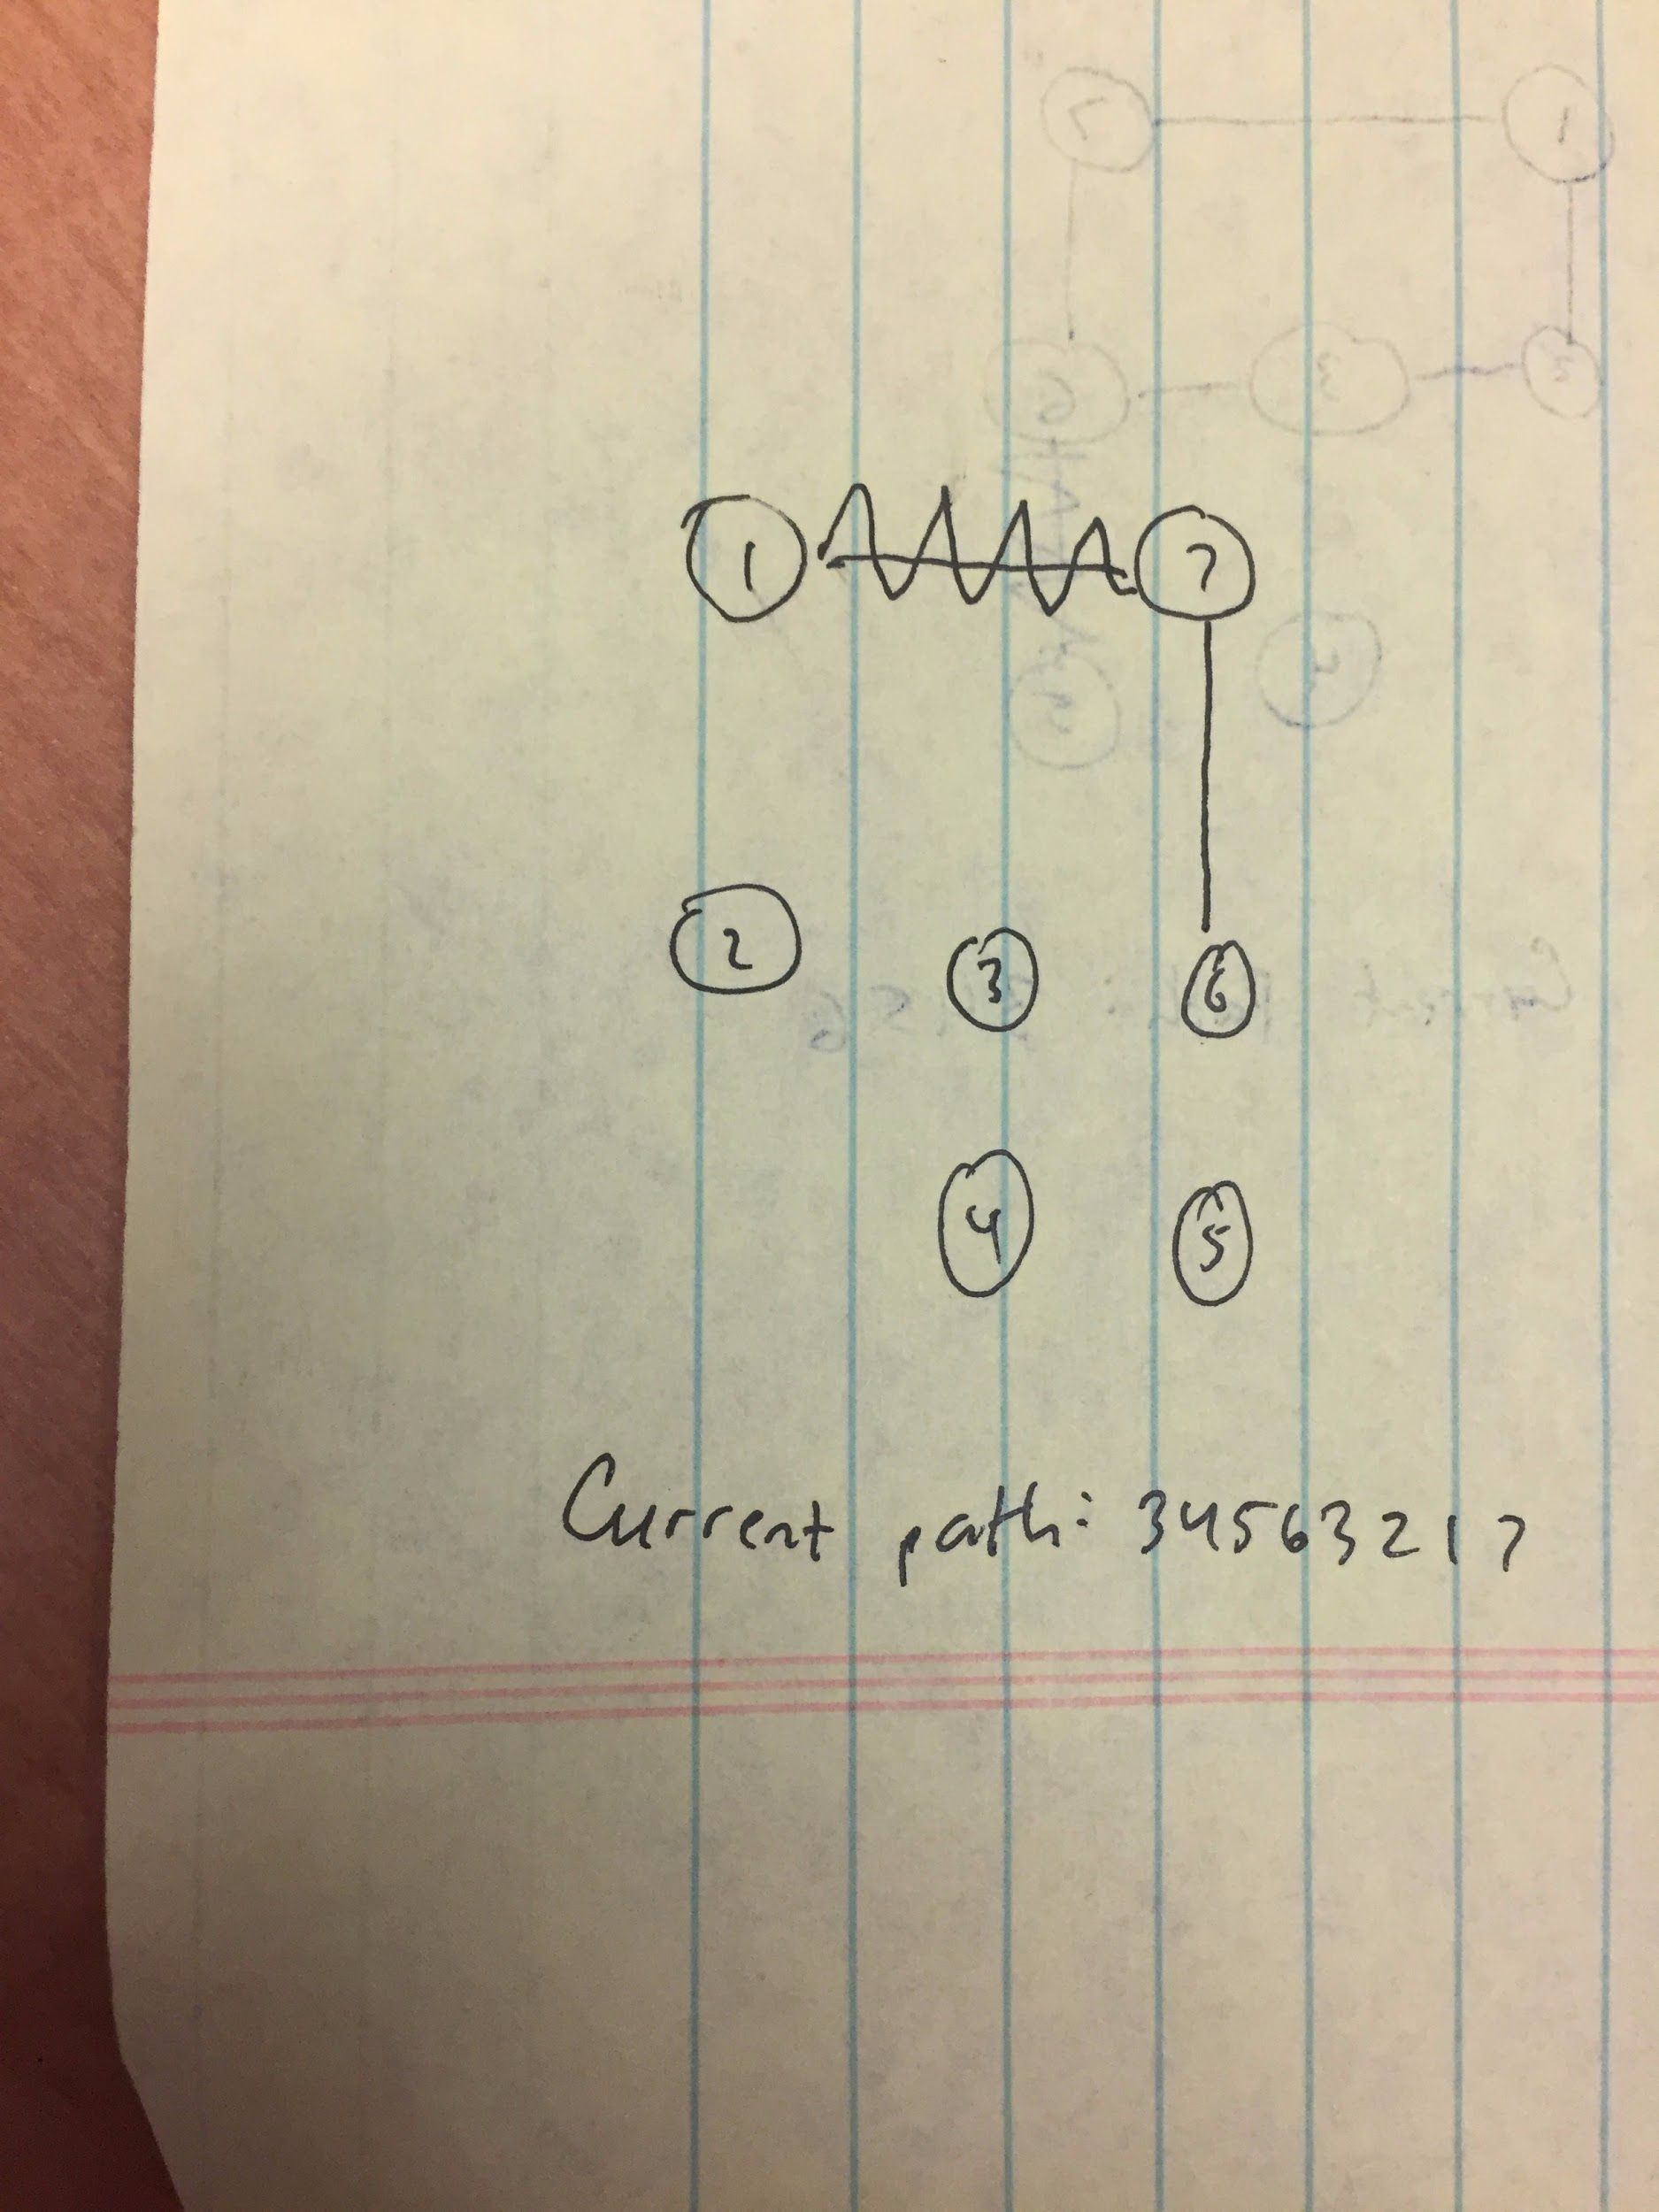

Slide 15
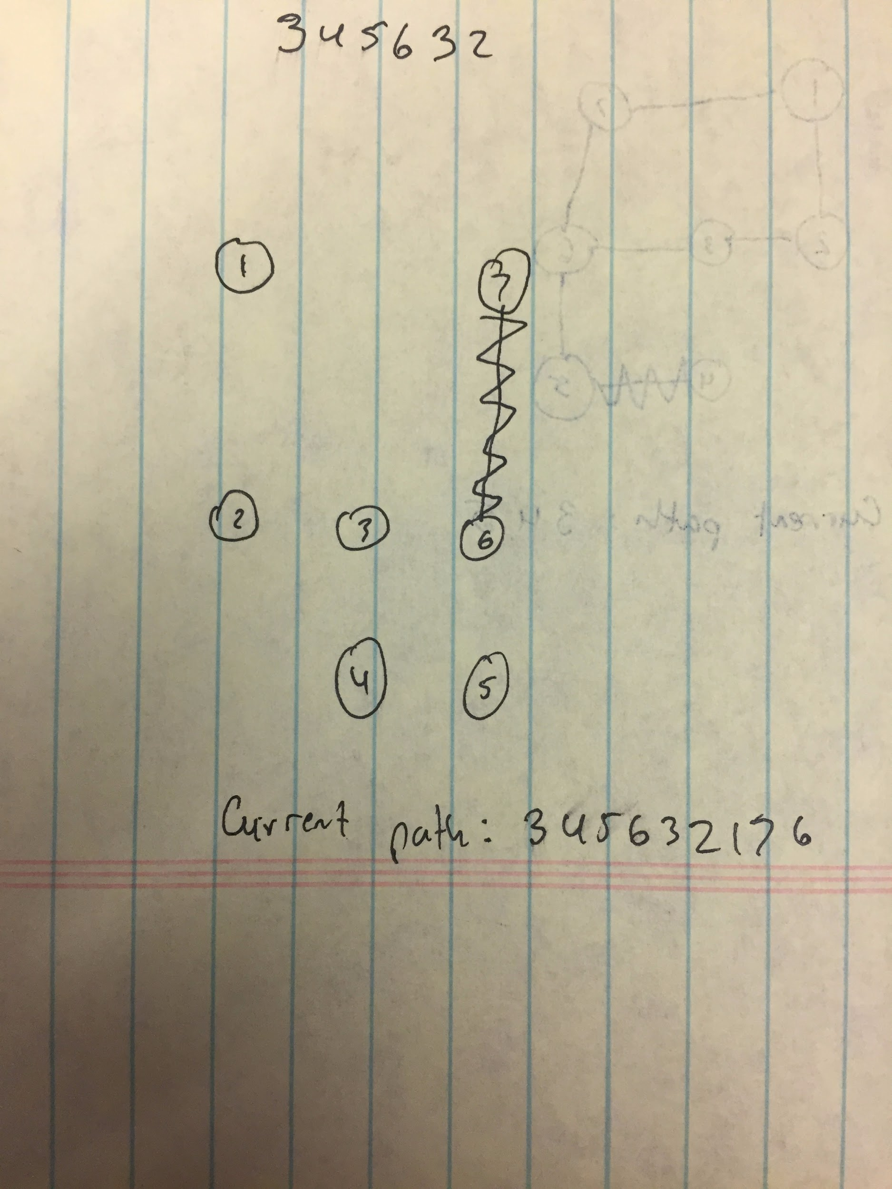

Slide 16
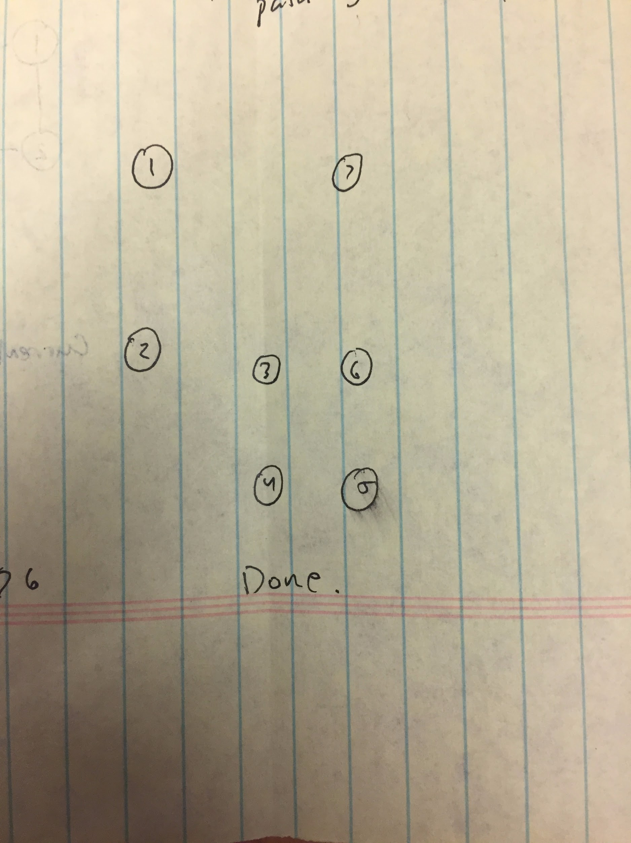

Slide 18
User Interface
Our application allows users to generate a graph of cities after which they have the option to add, remove, or print out cities. It will also allow you to traverse the graph and print out the Eulerian path of the graph (If possible).
Ask user to enter the file name
Add a city to your plan
Remove a city from your plan
Undo the previous action
Print your plan map to a file.

Slide 19
Demonstrate our program

Slide 20
Parting thoughts

Slide 21
Thank you!
Any questions?

